Slide 1
Multiple Linear Regression
Regularization

Slide 2
Topics
Why gradient descent?
Types of gradient descent
Bias vs Variance
Regularization
Lasso (L1)
Ridge (L2)

Slide 3
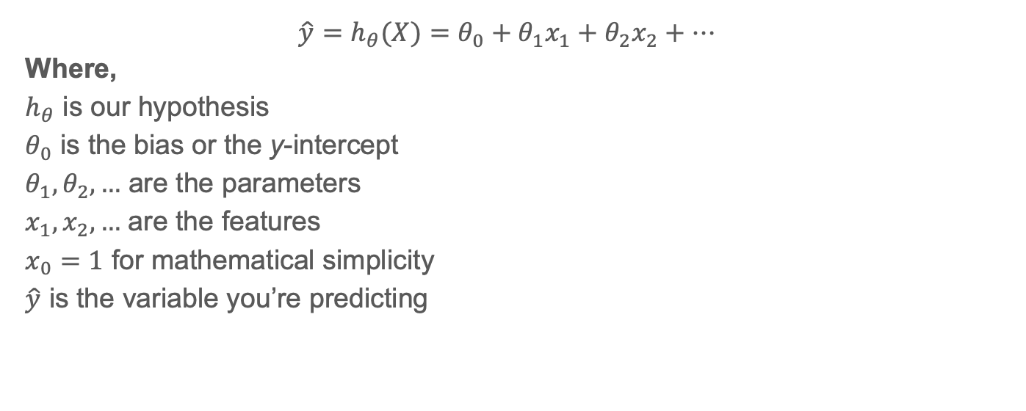
Notation (1)
$${\hat{y}=h}_{θ}(X)=θ_{0}+θ_{1}x_{1}+θ_{2}x_{2}+…$$
Where,
$h_{θ}$ is our hypothesis
$θ_{0}$ is the bias or the y-intercept
$θ_{1},θ_{2},…$ are the parameters
$x_{1},x_{2},…$ are the features
$x_{0}=1$ for mathematical simplicity
$\hat{y}$ is the variable you’re predicting

Slide 4
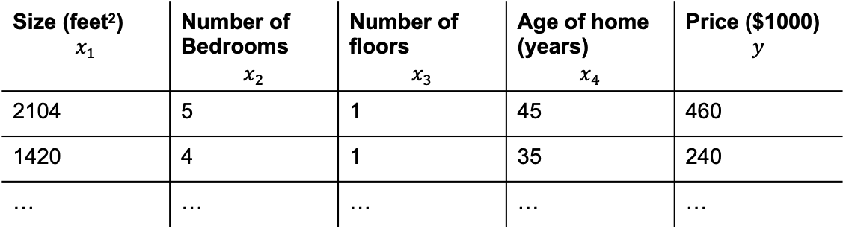
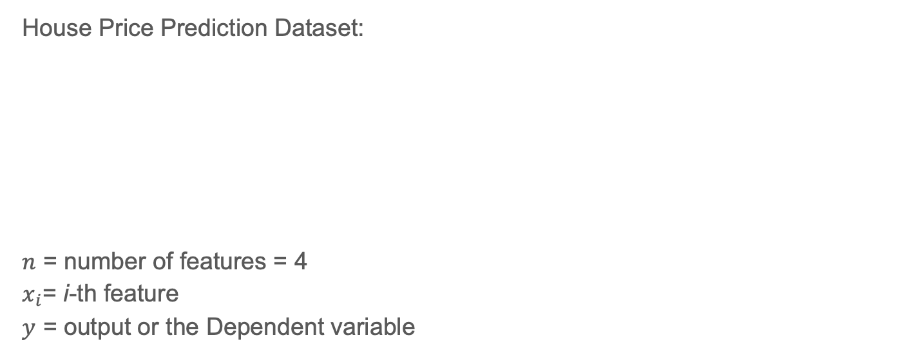
Notation (2)
House Price Prediction Dataset:
$n$ = number of features = 4
$x_{i}$= i-th feature
$y$ = output or the Dependent variable
Size (feet²) $$x_{1}$$ | Number of Bedrooms $$x_{2}$$ | Number of floors $$x_{3}$$ | Age of home (years) $$x_{4}$$ | Price ($1000) $$y$$
2104 | 5 | 1 | 45 | 460
1420 | 4 | 1 | 35 | 240
… | … | … | … | …

Slide 5
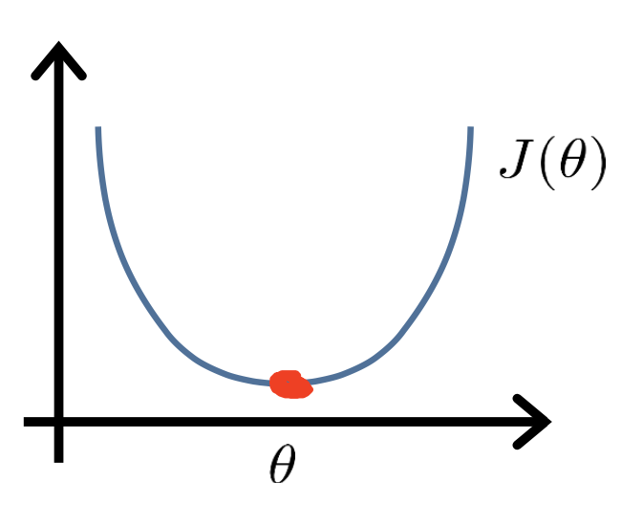
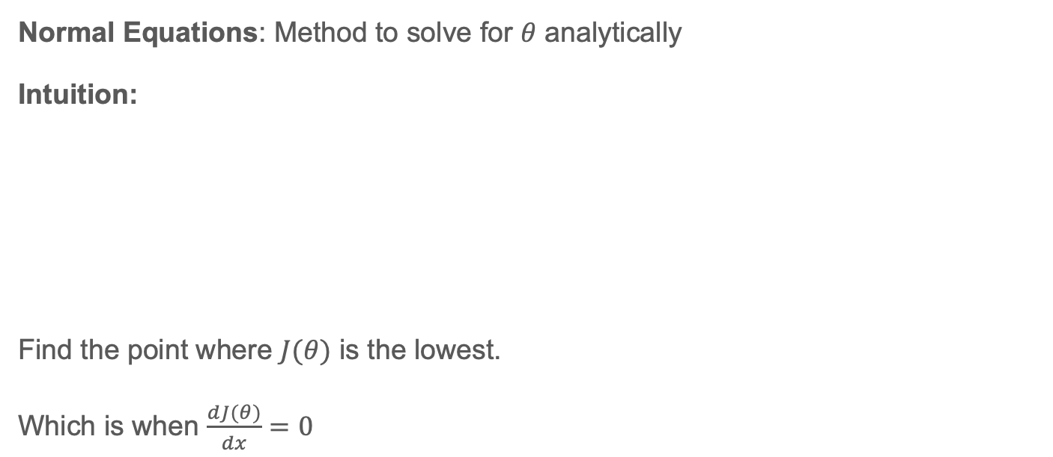
Why Gradient Descent? (1)
Normal Equations: Method to solve for $θ$ analytically
Intuition:
Find the point where $J(θ)$ is the lowest.
Which is when $\frac{dJ(θ)}{dx}=0$

Slide 6
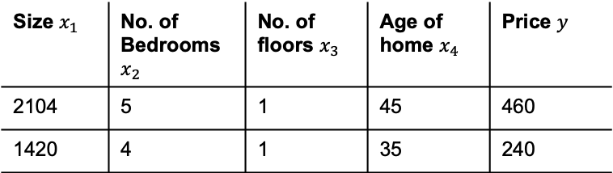
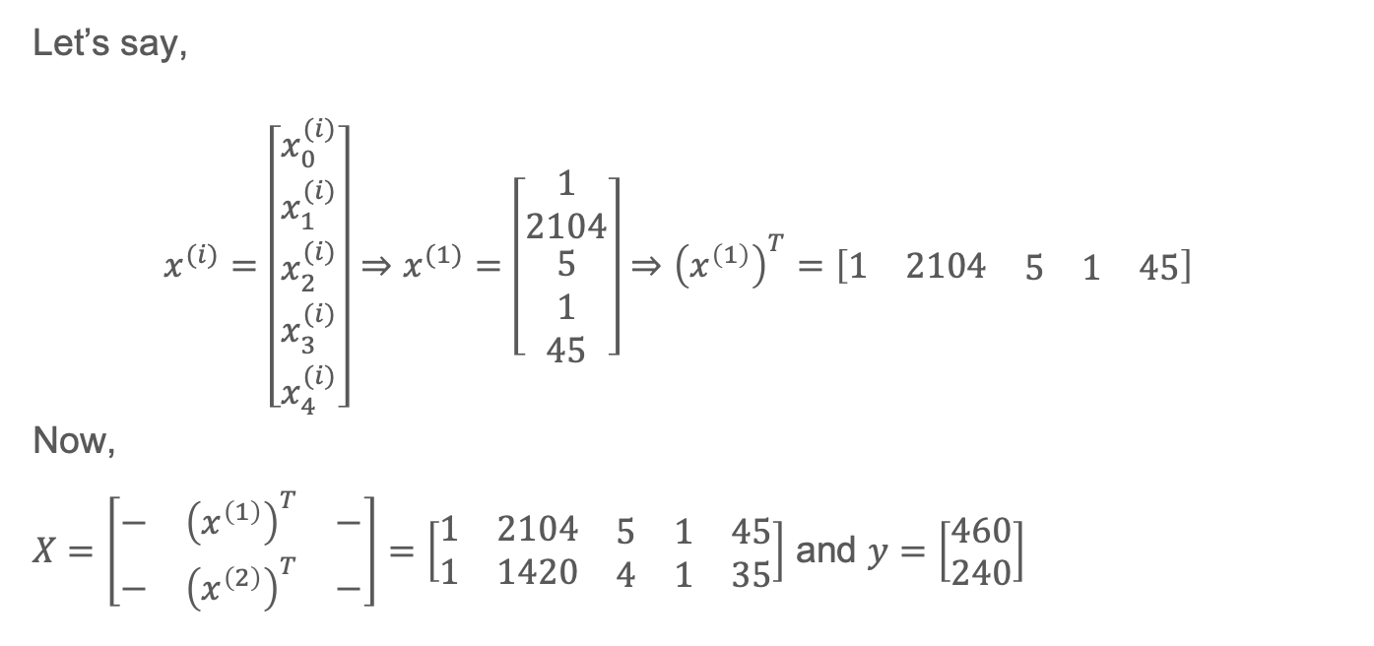
Why Gradient Descent? (2)
Size $x_{1}$ | No. of Bedrooms $x_{2}$ | No. of floors $x_{3}$ | Age of home $x_{4}$ | Price $y$
2104 | 5 | 1 | 45 | 460
1420 | 4 | 1 | 35 | 240
Let’s say,
$$x^{(i)}=\left[\begin{matrix}x_{0}^{(i)} \\ x_{1}^{(i)} \\ \begin{matrix}x_{2}^{(i)} \\ x_{3}^{(i)} \\ x_{4}^{(i)}\end{matrix}\end{matrix}\right]⇒x^{(1)}=\left[\begin{matrix}1 \\ 2104 \\ \begin{matrix}5 \\ 1 \\ 45\end{matrix}\end{matrix}\right]⇒{\left(x^{\left(1\right)}\right)}^{T}=\left[\begin{matrix}1 & 2104 & \begin{matrix}5 & 1 & 45\end{matrix}\end{matrix}\right]$$
Now,
$X=\left[\begin{matrix}− & {\left(x^{\left(1\right)}\right)}^{T} & − \\ − & {\left(x^{\left(2\right)}\right)}^{T} & −\end{matrix}\right]=\left[\begin{matrix}1 & 2104 & \begin{matrix}5 & 1 & 45\end{matrix} \\ 1 & 1420 & \begin{matrix}4 & 1 & 35\end{matrix}\end{matrix}\right]$ and $y=\left[\begin{matrix}460 \\ 240\end{matrix}\right]$

Slide 7
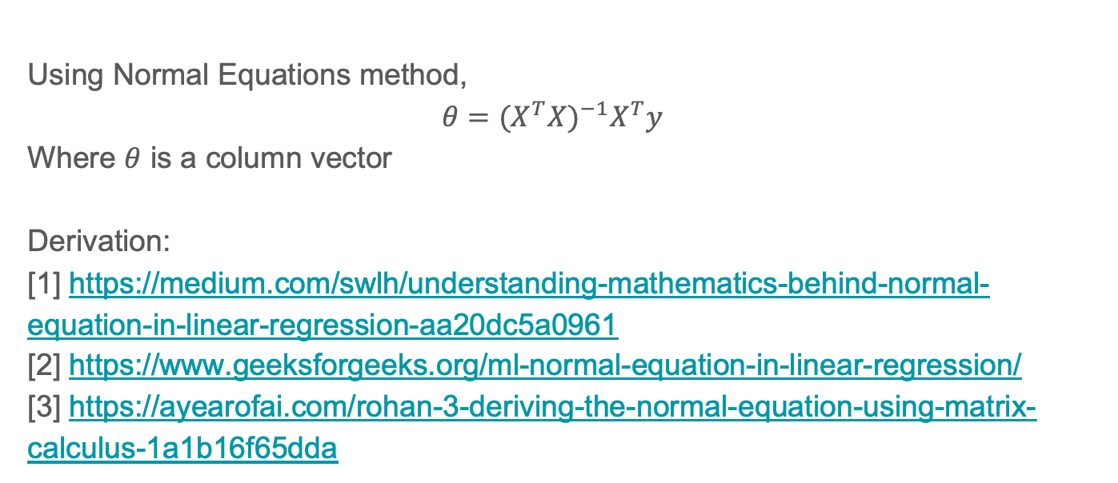
Why Gradient Descent? (3)
Using Normal Equations method,
$$θ={(X^{T}X)}^{−1}X^{T}y$$
Where $θ$ is a column vector
Derivation:
[1] https://medium.com/swlh/understanding-mathematics-behind-normal-equation-in-linear-regression-aa20dc5a0961
[2] https://www.geeksforgeeks.org/ml-normal-equation-in-linear-regression/
[3] https://ayearofai.com/rohan-3-deriving-the-normal-equation-using-matrix-calculus-1a1b16f65dda

Slide 8
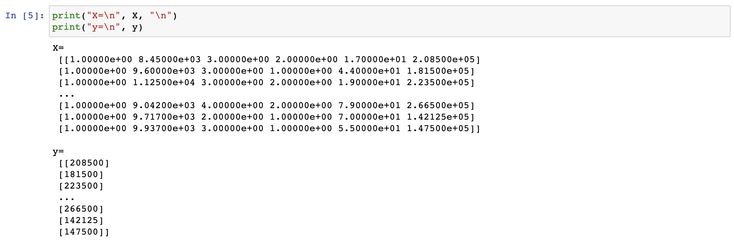
Why Gradient Descent? (4)

Slide 9
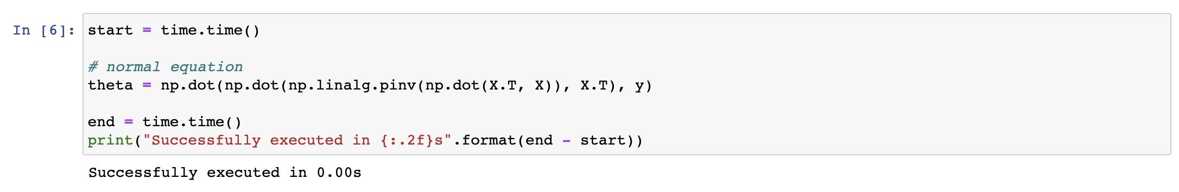
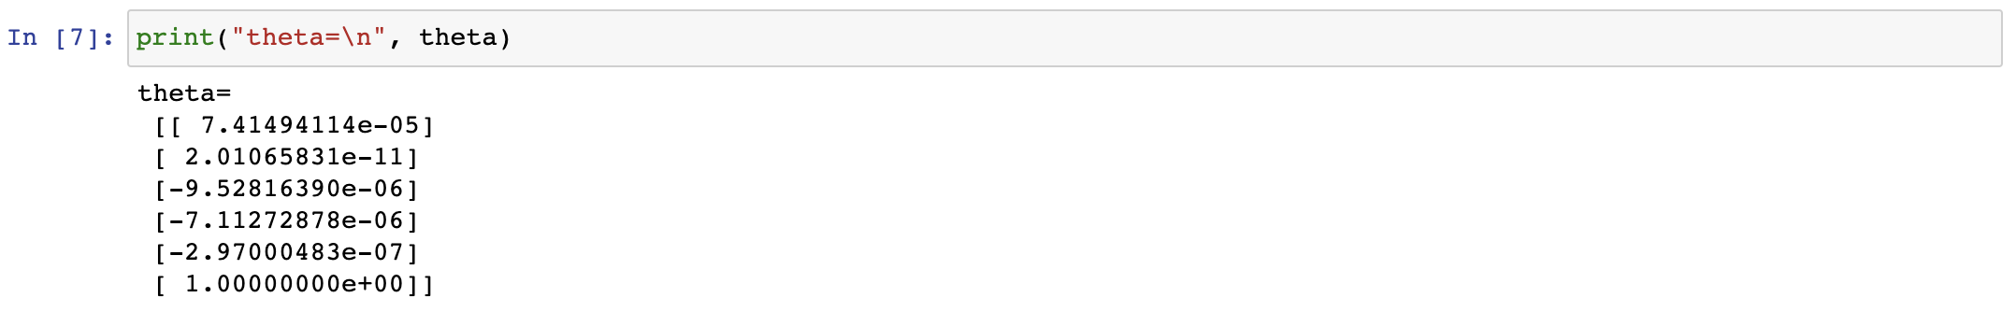
Why Gradient Descent? (5)

Slide 10
Why Gradient Descent? (6)

Slide 11
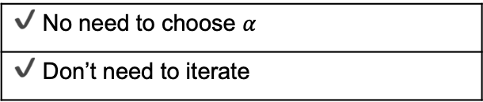
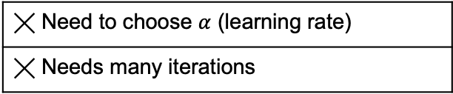
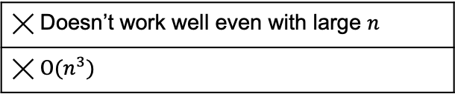
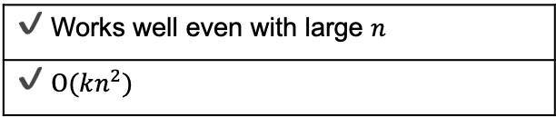
Why Gradient Descent? (7)
Gradient Descent
Normal Equations Method
╳ Need to choose $α$ (learning rate)
╳ Needs many iterations
✔️ No need to choose $α$
✔️ Don’t need to iterate
✔️ Works well even with large $n$
✔️ $Ο(kn^{2})$
╳ Doesn’t work well even with large $n$
╳ $Ο(n^{3})$

Slide 12
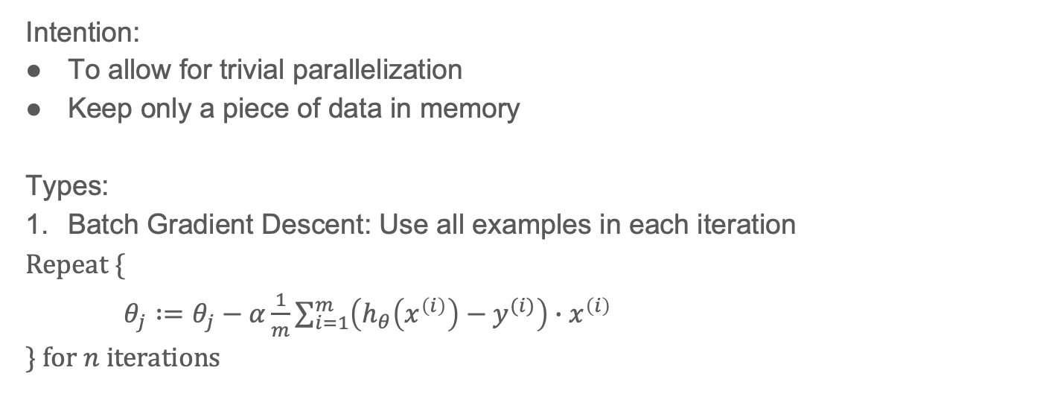
Types of Gradient Descent (1)
Intention:
To allow for trivial parallelization
Keep only a piece of data in memory
Types:
Batch Gradient Descent: Use all examples in each iteration
$\text{Repeat} \{$
$θ_{j}∶=θ_{j}−α\frac{1}{m}\sum_{i=1}^{m}{\left(h_{θ}\left(x^{\left(i\right)}\right)−y^{(i)}\right)∙x^{\left(i\right)}}$
$\} \text{for} n \text{iterations}$

Slide 13
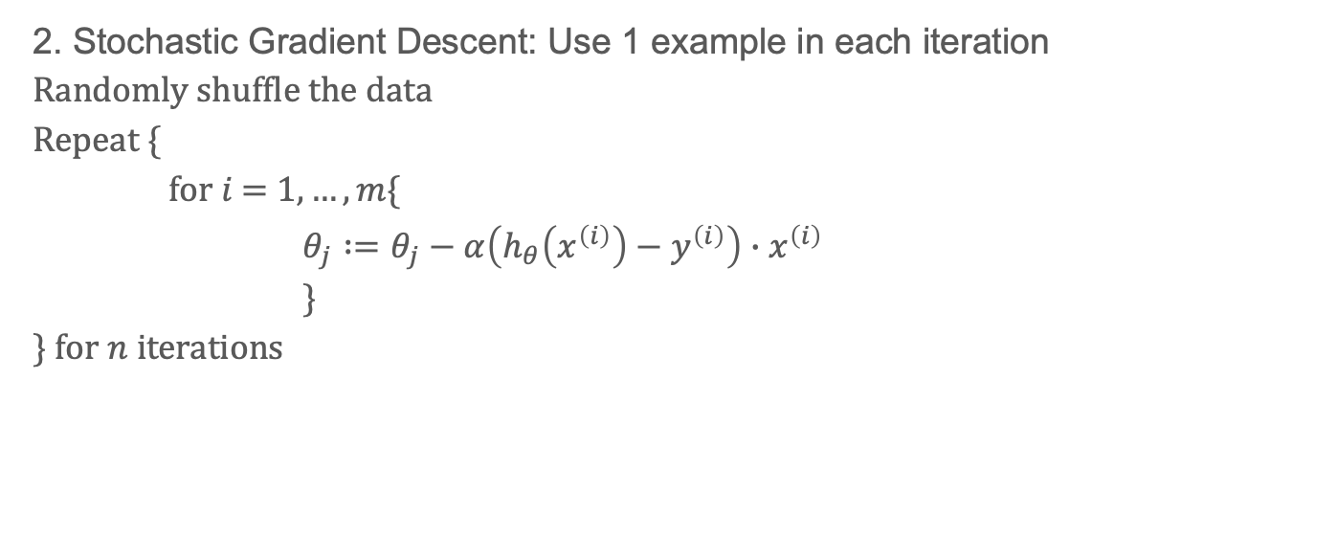
Types of Gradient Descent (2)
2. Stochastic Gradient Descent: Use 1 example in each iteration
$$\text{R}\text{andomly} \text{shuffle} \text{the} \text{data}$$
$\text{Repeat} \{$
$for i \text{= 1},…,m\{$
$θ_{j}∶=θ_{j}−α\left(h_{θ}\left(x^{\left(i\right)}\right)−y^{\left(i\right)}\right)∙x^{\left(i\right)}$
$\}$
$\} \text{for} n \text{iterations}$

Slide 14
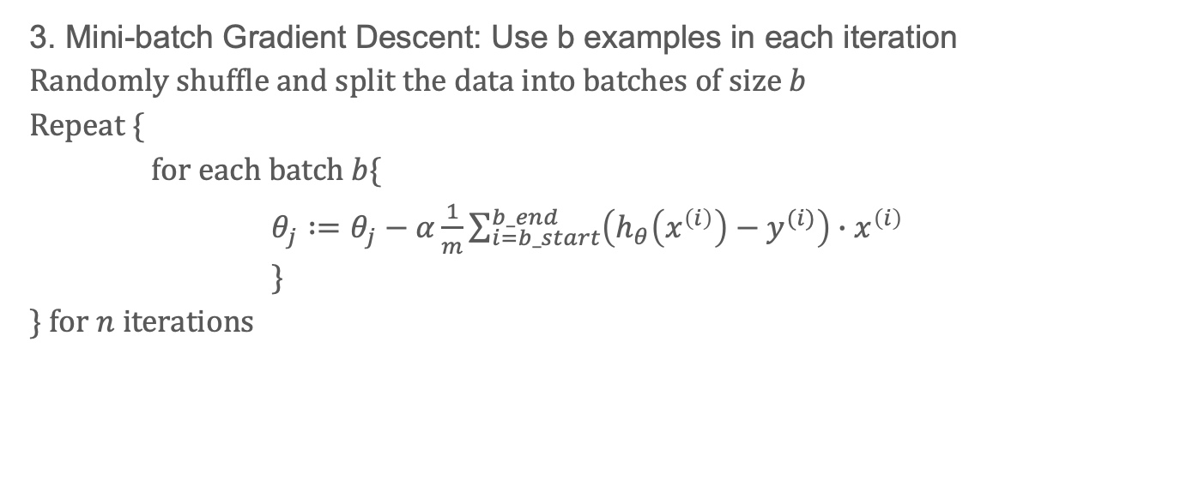
Types of Gradient Descent (3)
3. Mini-batch Gradient Descent: Use b examples in each iteration
$$\text{R}\text{andomly} \text{shuffle} \text{and} \text{split} \text{the} \text{data} \text{into} \text{batches} \text{of} \text{size} b$$
$\text{Repeat} \{$
$for \text{each} \text{batch} b\{$
$θ_{j}∶=θ_{j}−α\frac{1}{m}\sum_{i=b_start}^{b_end}{\left(h_{θ}\left(x^{\left(i\right)}\right)−y^{(i)}\right)∙x^{\left(i\right)}}$
$\}$
$\} \text{for} n \text{iterations}$
Compute this for $b_{0}$ $i=0…99$ | Compute this for $b_{1}$ $i=100…199$ | Compute this for $b_{2}$ $i=200…299$

Slide 15
Bias vs Variance (1) - Bias
Assumptions made by a model to make the target function easier to learn
Generally, linear algorithms have a high bias:
Fast to learn and easier to understand
But less flexible
Thus, low predictive performance
Low Bias: Suggests fewer assumptions about the form of the target function.
High Bias: Suggests more assumptions about the form of the target function.
E.g. Linear Regression assumes:
Normality of residuals around 0
No multicollinearity
No autocorrelation of residuals
Homoscedasticity of residuals

Slide 16
Bias vs Variance (2) - Variance
Amount that the estimate of the target function will change if different training data was used.
specifics of the training influences the number and types of parameters used to characterize the mapping function
Low Variance: Suggests small changes to the estimate of the target function with changes to the training dataset.
High Variance: Suggests large changes to the estimate of the target function with changes to the training dataset.
Generally, nonlinear machine learning algorithms that have a lot of flexibility have a high variance.
E.g., decision trees have a high variance, that is even higher if the trees are not pruned before use.

Slide 17
Bias vs Variance (3)
There is no escaping the relationship between bias and variance in machine learning.
Increasing the bias will decrease the variance.
Increasing the variance will decrease the bias.

Slide 18
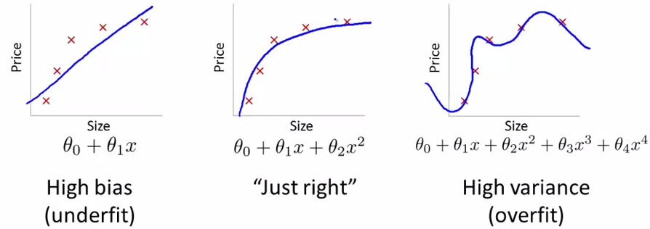
Bias vs Variance (4)
High bias
(underfit)
Cannot capture underlying trend
“Just right”
High variance
(overfit)
Captures the noise of the data

Slide 19
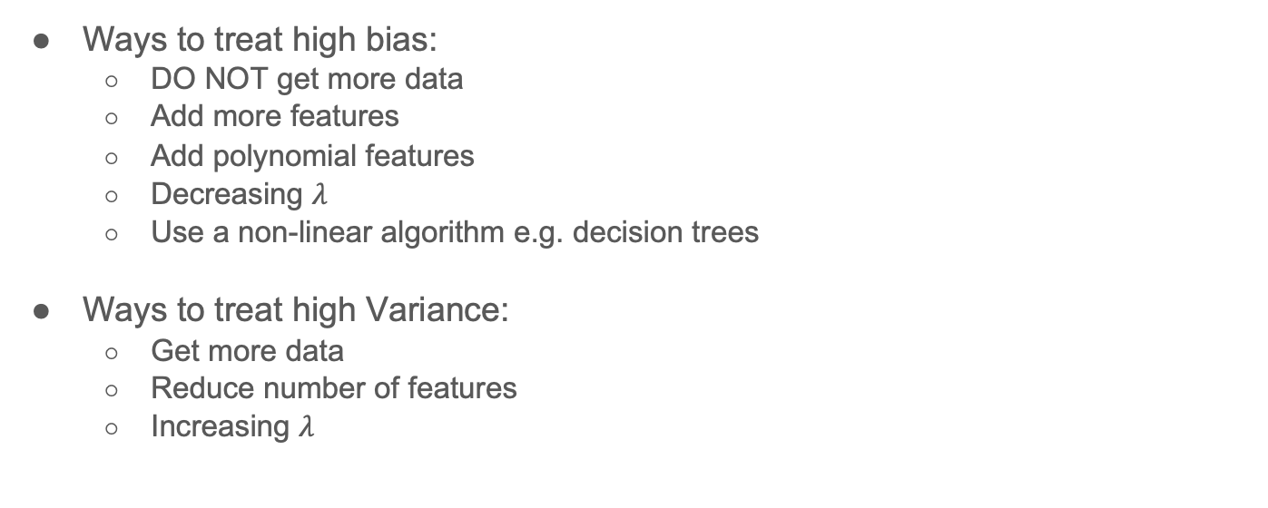
Bias vs Variance (4)
Ways to treat high bias:
DO NOT get more data
Add more features
Add polynomial features
Decreasing $λ$
Use a non-linear algorithm e.g. decision trees
Ways to treat high Variance:
Get more data
Reduce number of features
Increasing $λ$

Slide 20
Regularization (1)
Helps solve overfitting problem
Intuition:
Large weights tend to cause overfitting
Large weights are more sensitive to small noises
in the feature space, only directions along which the parameters contribute significantly to reducing the objective function are preserved
E.g. if number of bedrooms is not contributing to price, no point in assigning a large weight to it
adding a penalty term to the objective function

Slide 21
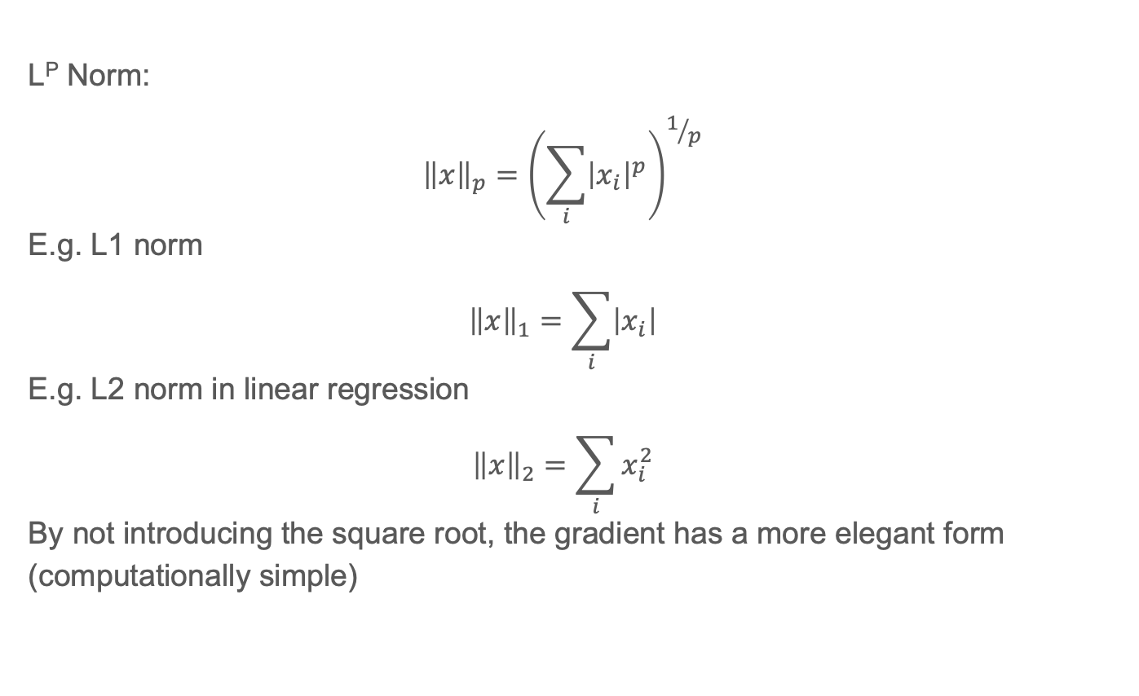
Regularization (2)
L^{P} Norm:
$${\left\|x\right\|}_{p}={\left(\sum_{i}{{\left|x_{i}\right|}^{p}}\right)}^{1/p}$$
E.g. L1 norm
$${\left\|x\right\|}_{1}=\sum_{i}{\left|x_{i}\right|}$$
E.g. L2 norm in linear regression
$${\left\|x\right\|}_{2}=\sum_{i}{x_{i}^{2}}$$
By not introducing the square root, the gradient has a more elegant form (computationally simple)

Slide 22
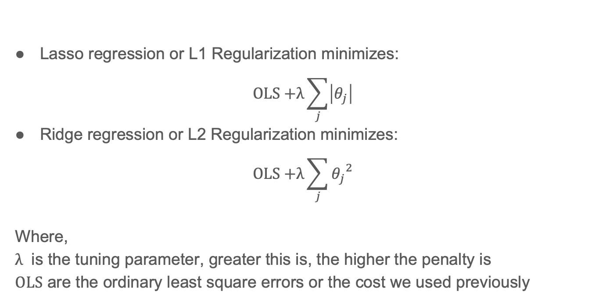
Regularization (3)
Lasso regression or L1 Regularization minimizes:
$$\text{OLS}\text{ +}λ\sum_{j}{\left|θ_{j}\right|}$$
Ridge regression or L2 Regularization minimizes:
$$\text{OLS}\text{ +}λ\sum_{j}{{θ_{j}}^{2}}$$
Where,
$λ$ is the tuning parameter, greater this is, the higher the penalty is
$\text{OLS}$ are the ordinary least square errors or the cost we used previously

Slide 23
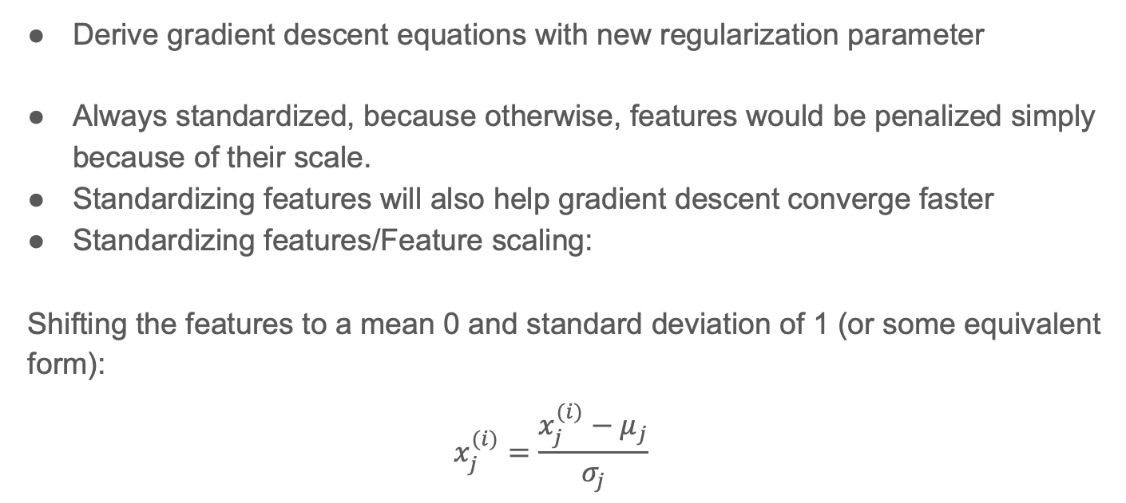
Regularization (4)
Derive gradient descent equations with new regularization parameter
Always standardized, because otherwise, features would be penalized simply because of their scale.
Standardizing features will also help gradient descent converge faster
Standardizing features/Feature scaling:
Shifting the features to a mean 0 and standard deviation of 1 (or some equivalent form):
$$x_{j}^{(i)}=\frac{x_{j}^{(i)}−μ_{j}}{σ_{j}}$$

Slide 24
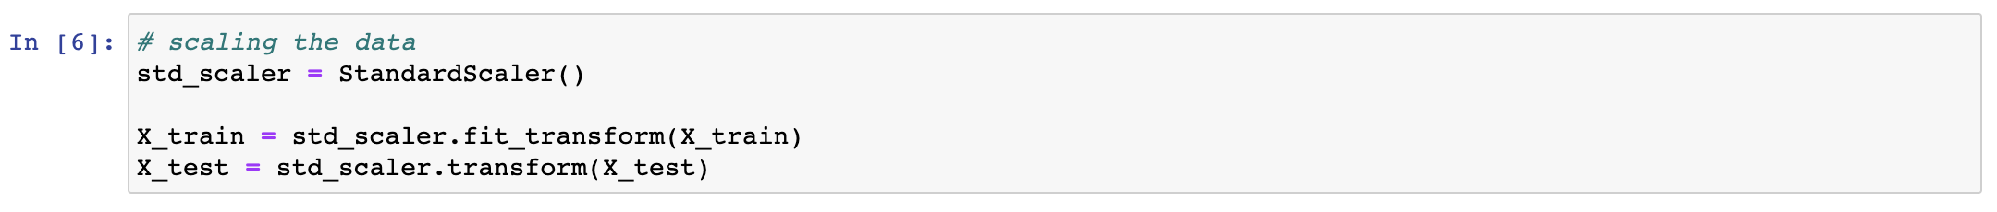
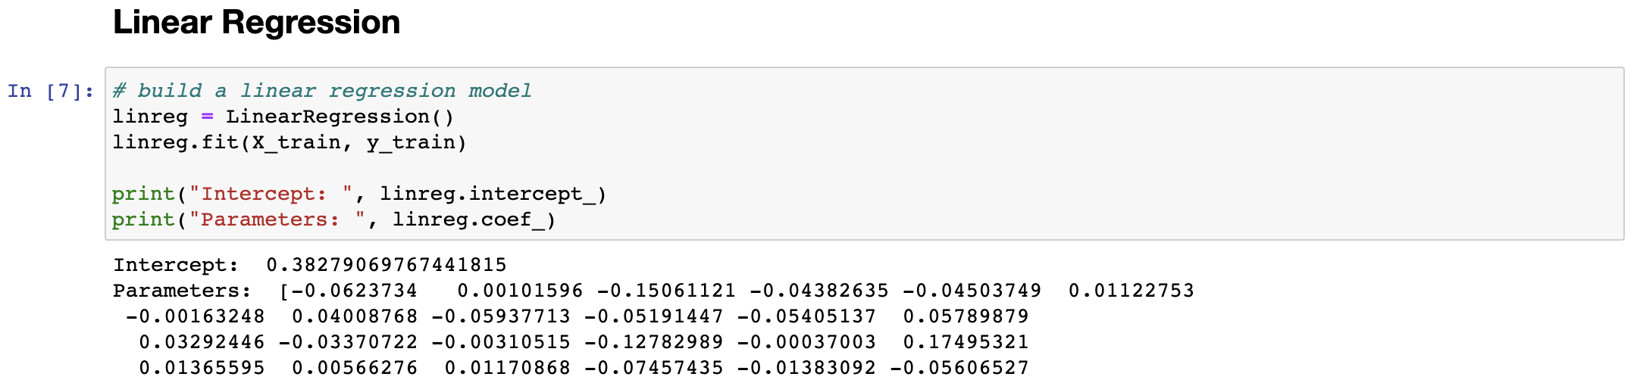
Regularization (5) – Linear Regression

Slide 25
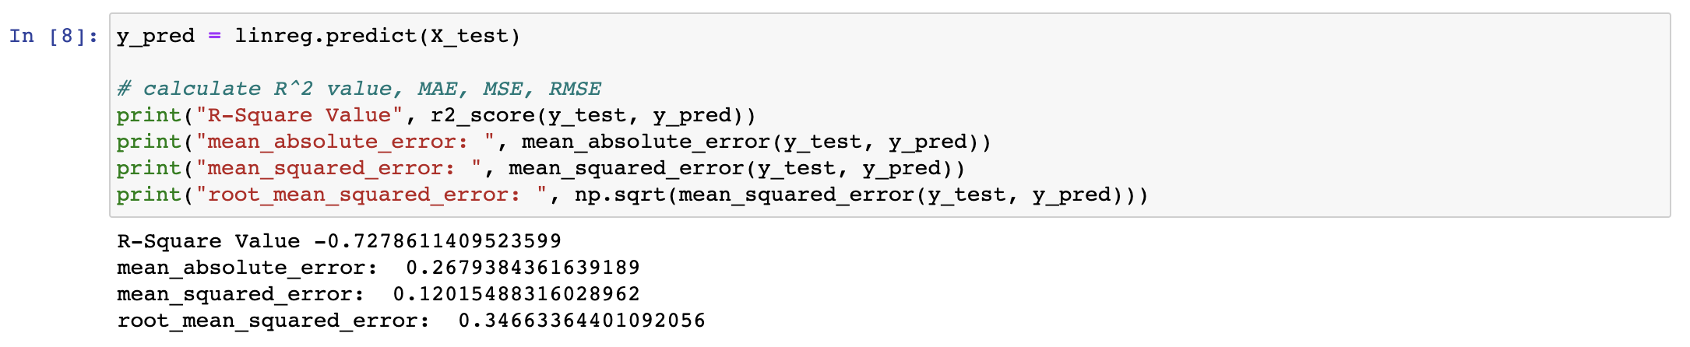
Regularization (6) – Linear Regression

Slide 26
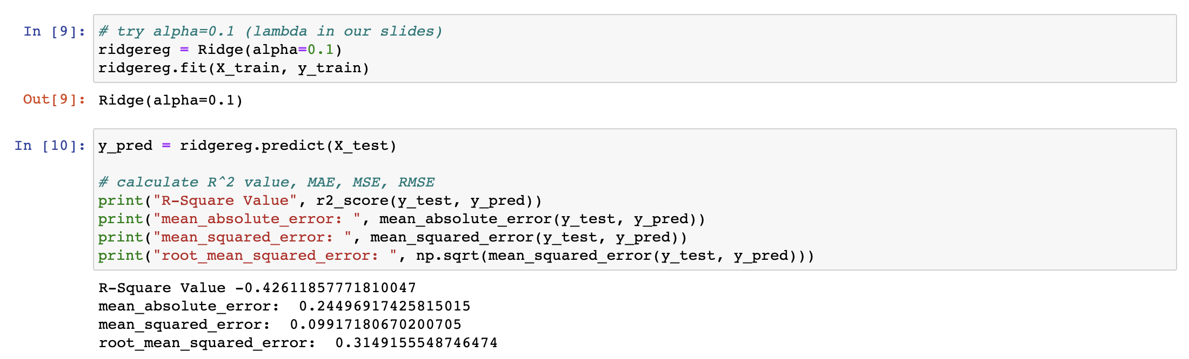
Regularization (7) – Ridge Regression

Slide 27
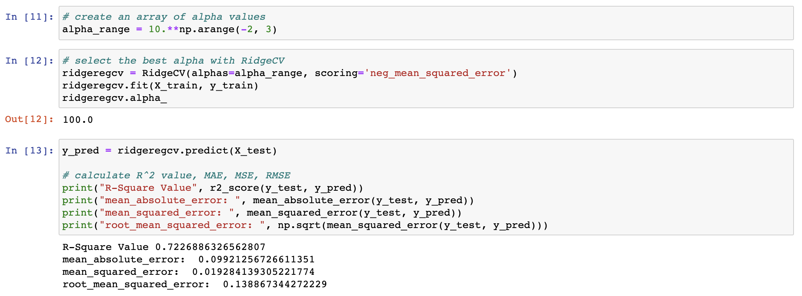
Regularization (7) – RidgeCV Regression

Slide 28
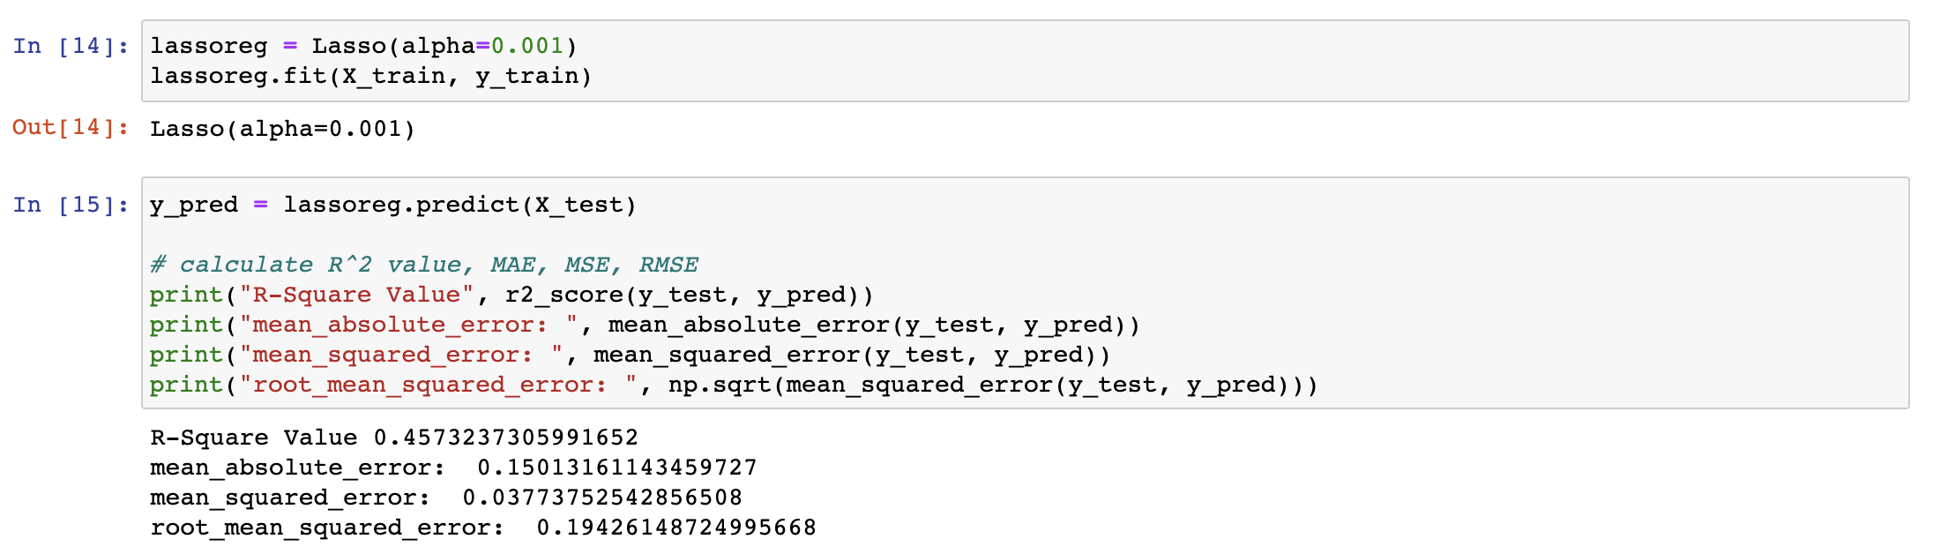
Regularization (8) – Lasso Regression

Slide 29
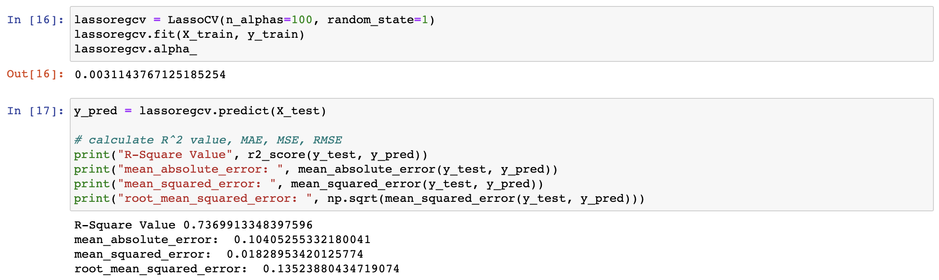
Regularization (9) – LassoCV Regression

Slide 30
Regularization (10) - Comparison
 | Linear Regression | Ridge Regression | RidgeCV Regression | Lasso Regression | LassoCV Regression
MAE | 0.268 | 0.245 | 0.099 | 0.037 | 0.0031
RMSE | 0.3466 | 0.3149 | 0.1389 | 0.1942 | 0.1352

Slide 31
Conclusion
Always check to ensure conditions of MLR are met – normality of residuals, no autocorrelation of residuals, etc.
Try out a series of models
Grid search/Randomly search/Bayesian search for your hyperparameters – lambda and alpha
Cross-validate your models
Pick one with lowest error

Slide 32
References
[1] https://machinelearningmastery.com/gentle-introduction-to-the-bias-variance-trade-off-in-machine-learning/
[2] http://r-statistics.co/Assumptions-of-Linear-Regression.html
[3] https://datascience.stackexchange.com/questions/23287/why-large-weights-are-prohibited-in-neural-networks
[4] https://stats.stackexchange.com/questions/449748/why-does-l-2-norm-regularization-not-have-a-square-root
[5] https://medium.com/@harishreddyp98/regularization-in-python-699cfbad8622

